Slide 1

Movie Data Visualization Platform
MDVP Project
Team 3 - Movie Masters

Slide 2
Table of Contents
01
02
03
04
Introduction
Requirement Analysis
Management Plan
Related Work & Demo

Slide 3
01
Introduction
Planning Phase

Slide 4
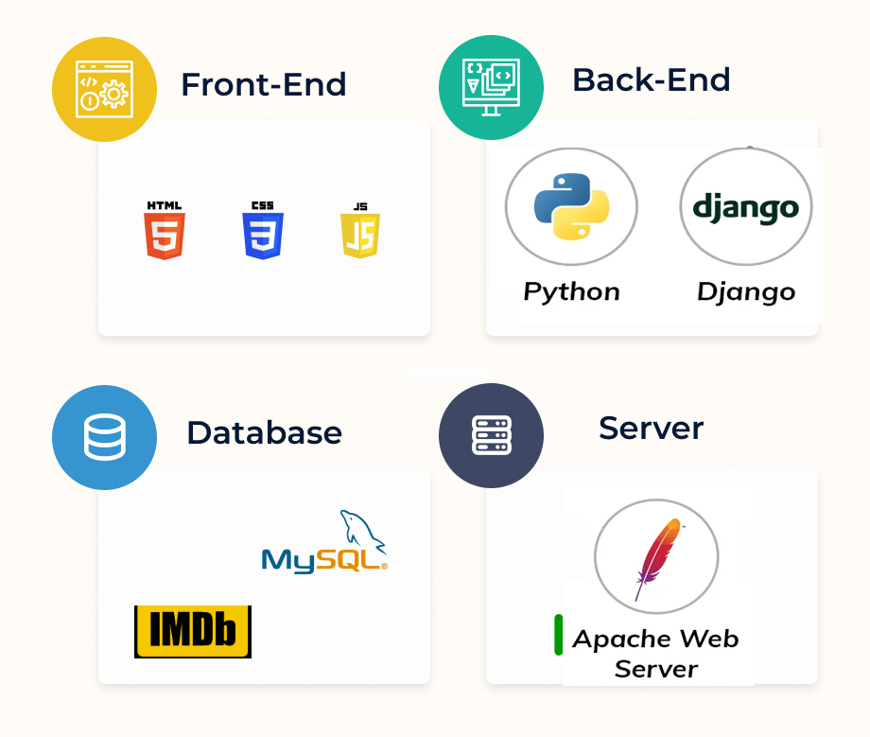
Web Development Stack

Slide 5
Our Project
MDVP
We aim to build a web-based platform for analyzing and visualizing IMDb movie data, motivated by the need to efficiently process large datasets and make it easy to identify trends and insights into the film industry.

Slide 6
Our Team Members
Hengyi Song
Design & Implementation
Leader
Xuansheng Xia
Team Leader
Mingyuan Xu
Configuration
Leader
Ziliang Ren
QA
Leader
Xiaojuan Li
Requirement
Leader

Slide 7
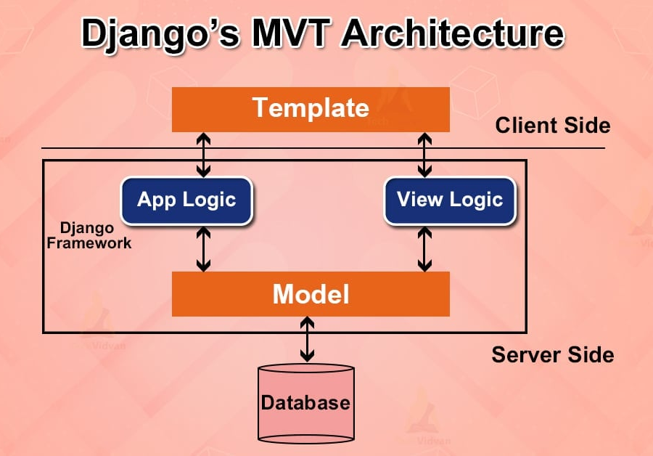
Introduction to Django
What is Django?
High-level Python web framework
Built-in functionality ("batteries included")
Focuses on rapid development and clean design
Secure and scalable, ideal for large datasets
Why Django for Our Project??
Built-in Admin Panel: Simplifies data management
ORM: Easy database interaction
Scalability: Supports growing datasets like IMDB

Slide 8
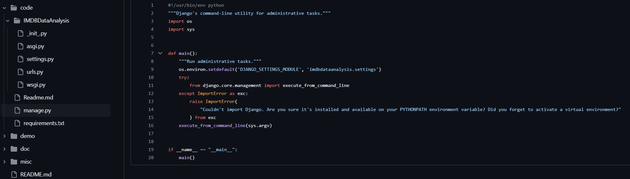
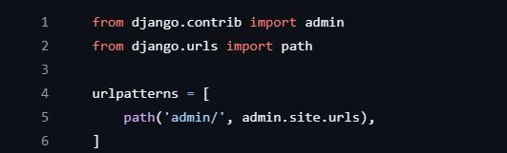
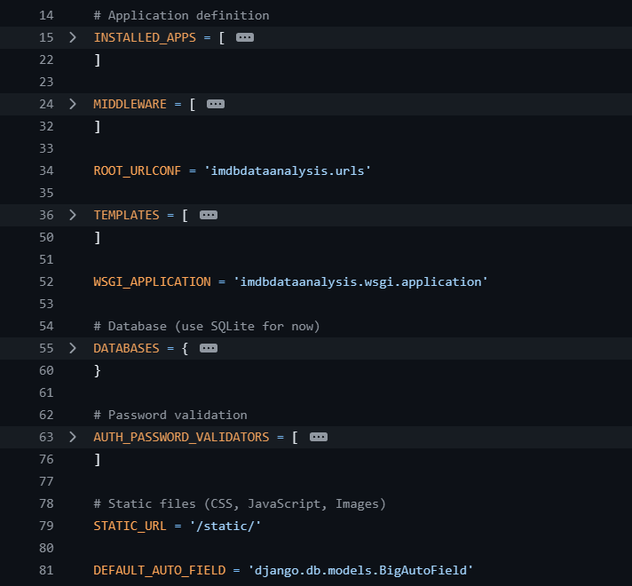
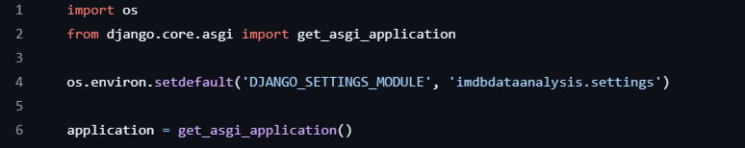
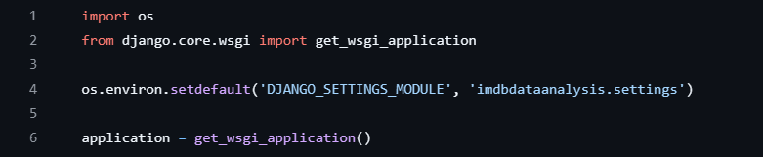
manage.py: The main entry point for running the Django project.
For deploying the project using traditional WSGI servers
Show how routes are defined
For asynchronous deployment with ASGI servers
contains the project’s configurations

Slide 9
02
Requirement Analysis

Slide 10
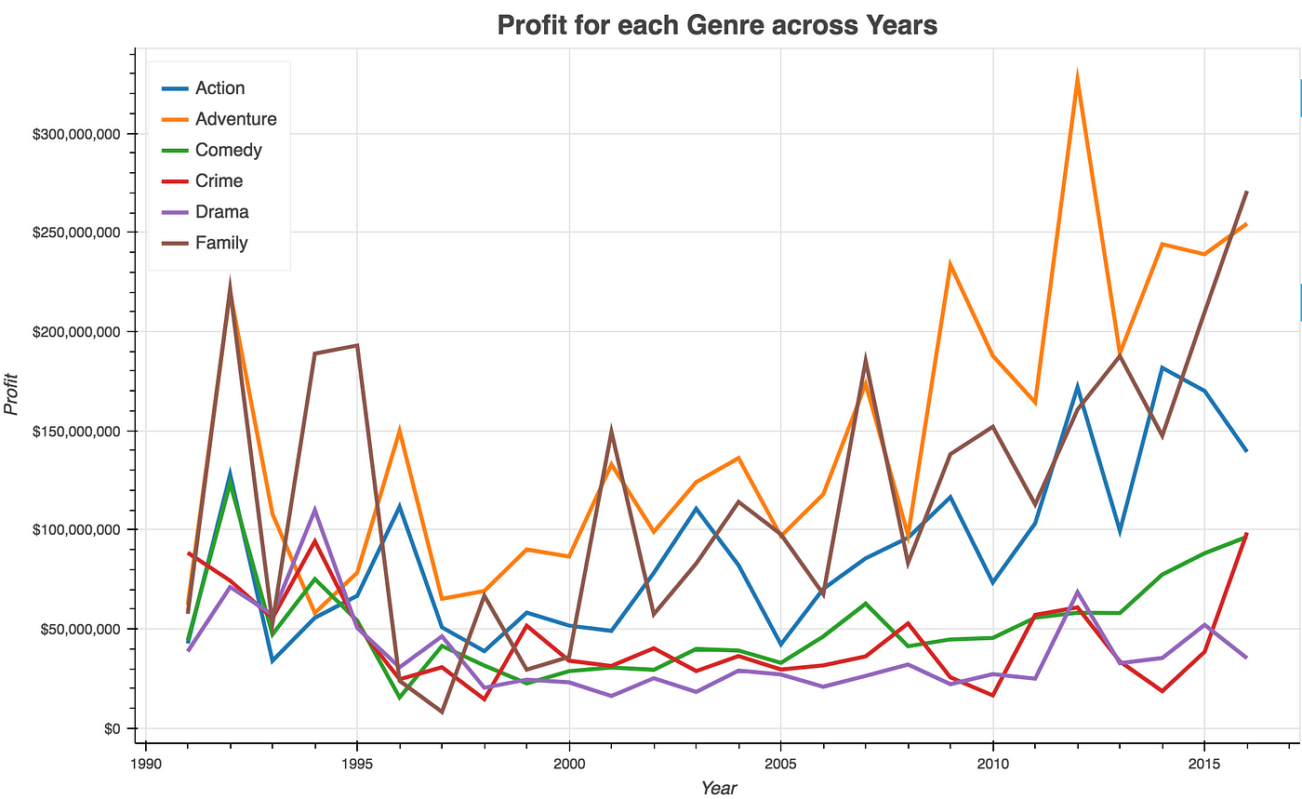
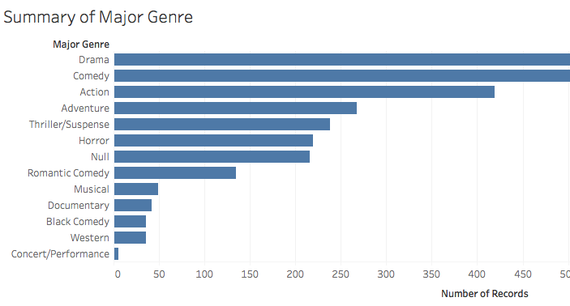
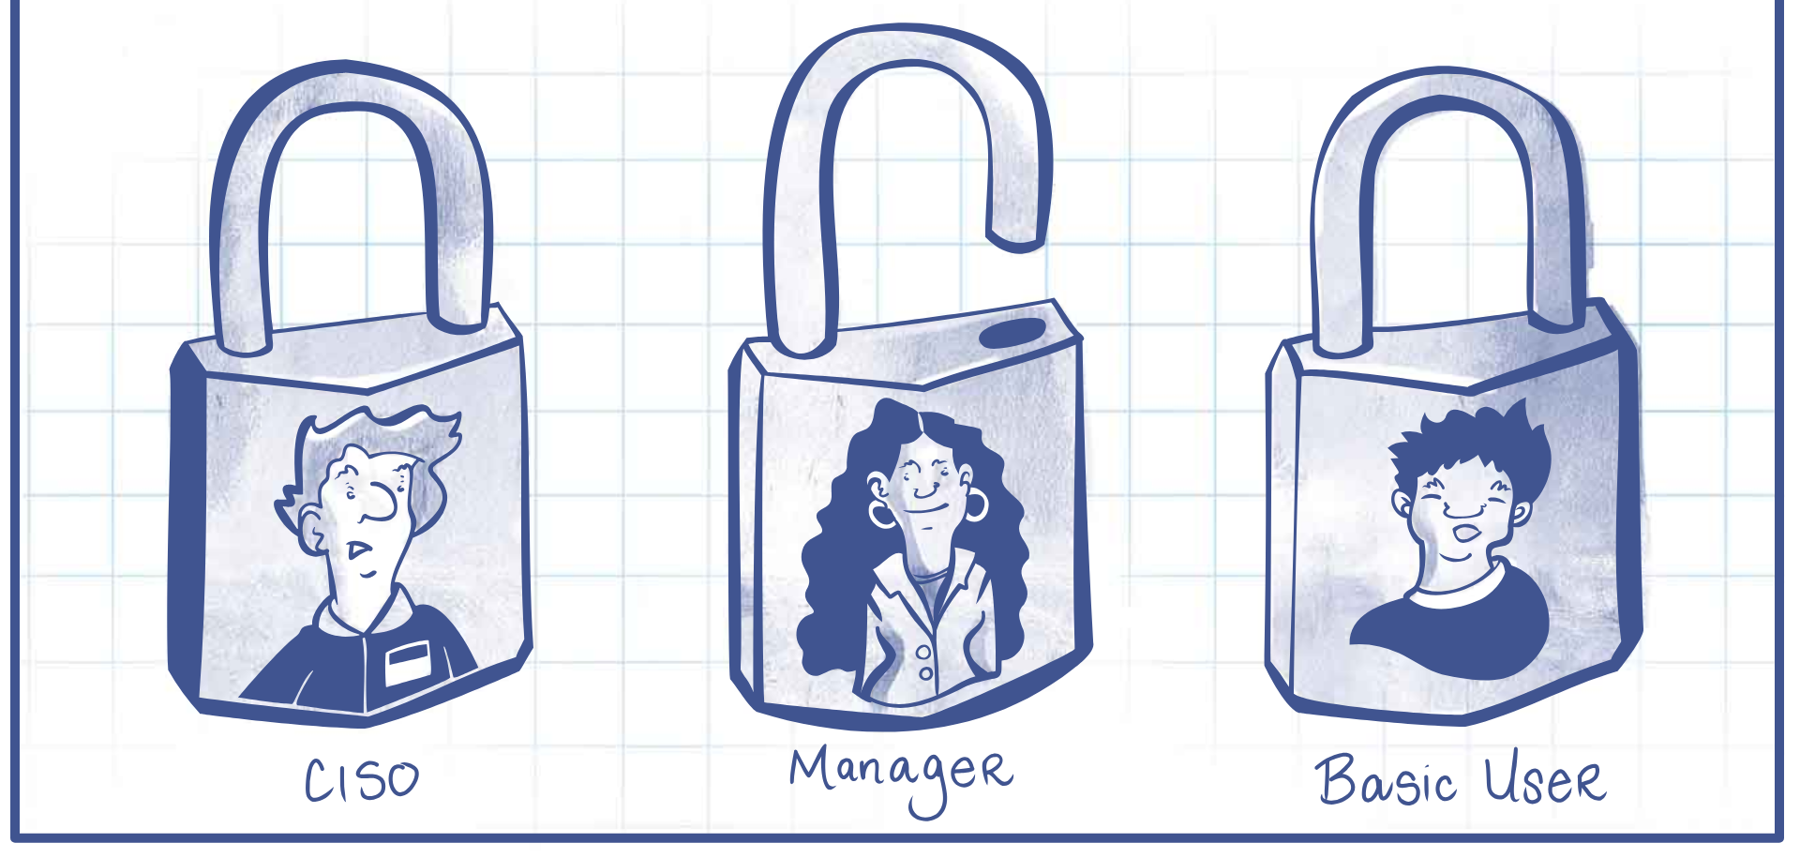
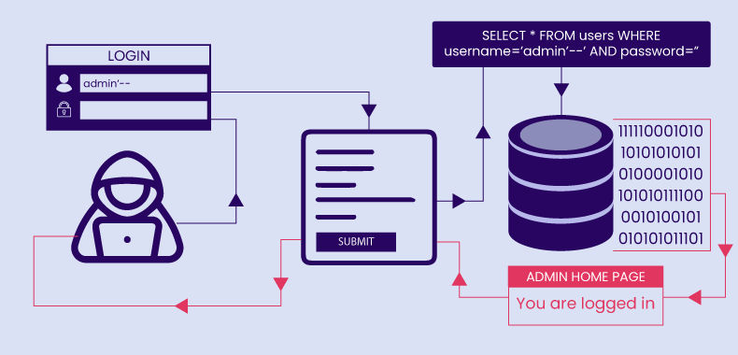
High-Level Requirements
Essential Features:
Interactive Movie Data Visualization: Explore movie attributes (ratings, genres, release years, etc.)design
Box Office and Genre Insights: Visualize movie ratings and box office performance
Movie Duration & Language Analysis: Analyze runtimes and language diversity
Nonfunctional Requirements:
Role-Based Access Control: Restrict admin tasks
Database Security: Protect against unauthorized access and SQL injection
API Security: Safeguard external data with secure API key handling

Slide 11
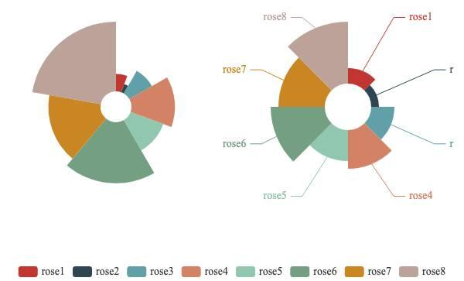
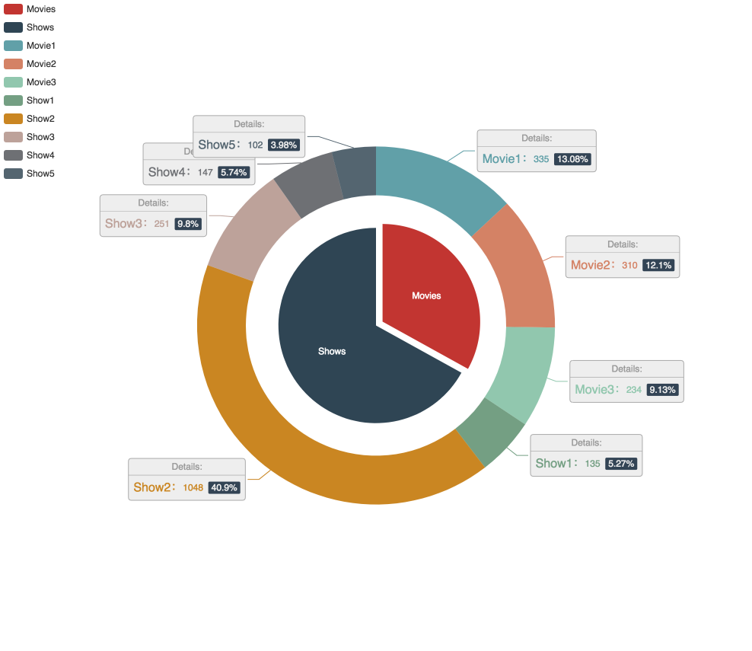
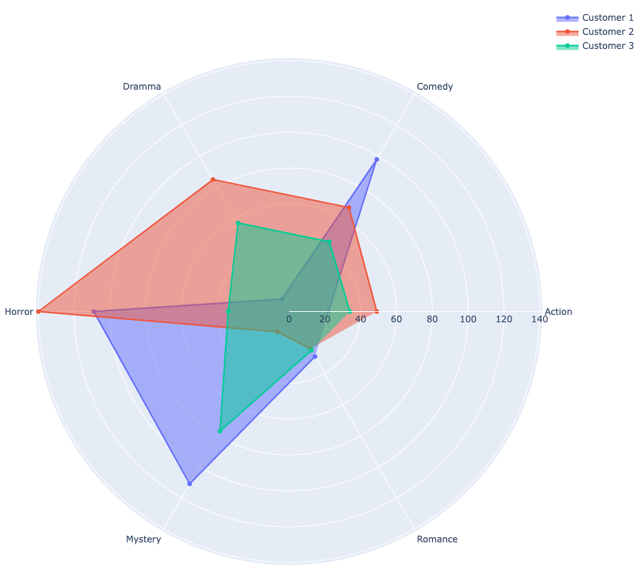
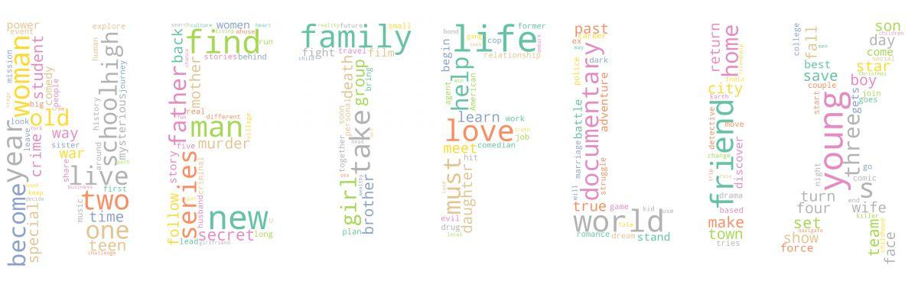
Key Functions – Data Visualization and Sentiment Analysis
Interactive Data Visualization:
Explore ratings, box office, genres, release years
Sentiment Analysis & Word Cloud:
Analyze movie reviews for user feedback

Slide 12
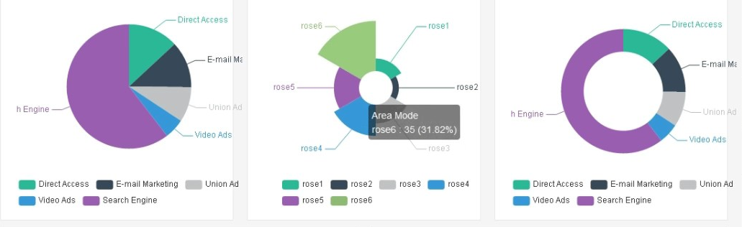
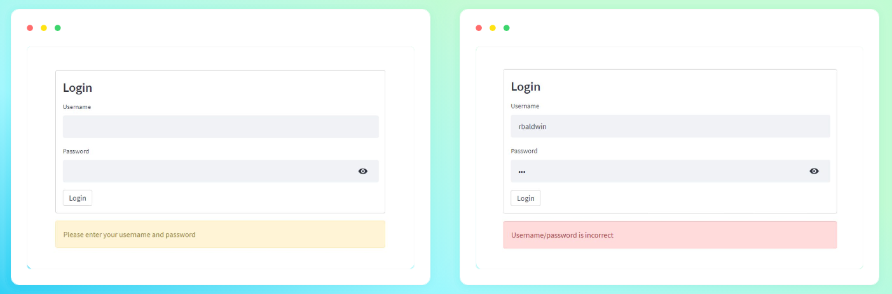
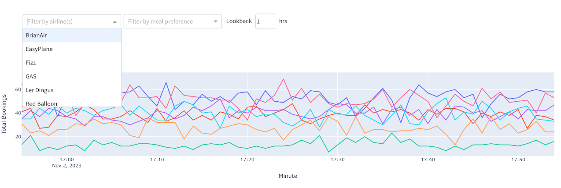
Additional Features
Customizable Data Filters:
Filter by ratings, genres, languages
User Accounts and Preferences:
Save dashboard settings
Real-Time Data Refresh:
Automatic updates of movie data

Slide 13
03
Management Plan

Slide 14
Our Process
Initial Planning
Set up tools, define project scope, and assign team roles
Advanced Features & Refinement Implement additional features, optimize functionality, and fix issues
Iter 0
Iter 1
Iter 2
Iter 3
Core Functionality Development Build and test the core features and architecture of the project
Finalization & Testing Conduct final testing, resolve bugs, and complete the project for deployment

Slide 15
Risk Management Overview
Risk Categories:
Team Dynamics: Loss or lack of motivation in team members, improper task assignments
Project Planning & Communication: Duplicate work, unclear requirements, scope creep
Technical Competence: Lack of framework or programming knowledge, technology incompetence
Development & Testing Issues: Messy code, inadequate testing, improper design decisions
Time Constraints: Insufficient time for integration and deployment

Slide 16
Conclusion and Next Steps
Summary:
Project Overview: IMDB data visualization and analysis platform using Django.
Key Features: Data visualization, sentiment analysis, customizable filters.
Risk Management: Early identification of team, planning, technical, and time risks.
Next Steps:
Development Phase: Implement core functionalities and test features.
Team Collaboration: Continue refining tasks and mitigating identified risks.

Slide 17
04
Related Work & Our Demo

Slide 18
Related Work
Douban Platform
PowerBI IMDb Dashboard
Chinese DOUBAN Movie Data Analysis Platform
01
02
IMDB Movies Dashboard with PowerBI
Tableau Dashboard
MDVP
IMDB Dashboard Highlighting Jim Carrey based on Tableau
03
04
Our project: Movie Data Visualization Platform

Slide 19
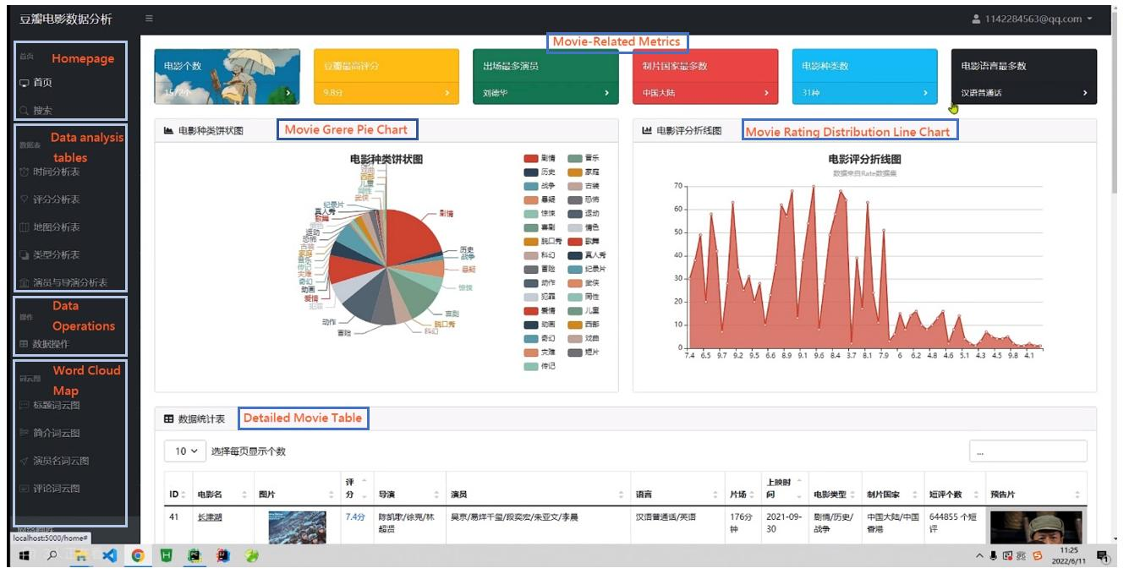

Slide 20
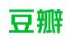
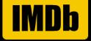
Differences
01
02
Douban Platform
Our Project-MDVP
It offers interactive visualizations and analytics on movie genres, ratings, production countries, and trends, focusing on Chinese-language films.
We provide more features like: box office performance, movie duration, and potential sentiment analysis, and customizable filters with a global view.

Slide 21
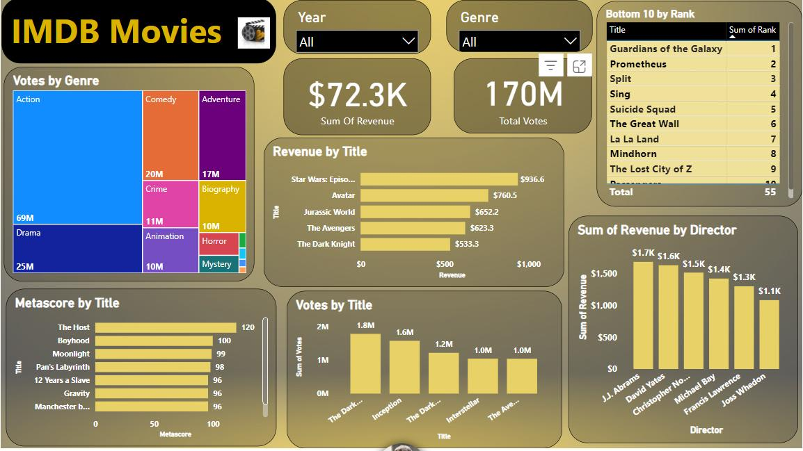

Slide 22
Differences
01
02
PowerBI Dashboard
Our Project - MDVP
It visualizes IMDb movie data, displaying votes by genre and title, individual and total movie revenues, director earnings, and meta score comparisons.
We offer deeper insights with features like detailed box office and genre analysis, movie duration and language diversity analysis, and potential real-time data refresh.
Based on PowerBI
From Scratch
Dashboard only
Platform

Slide 23
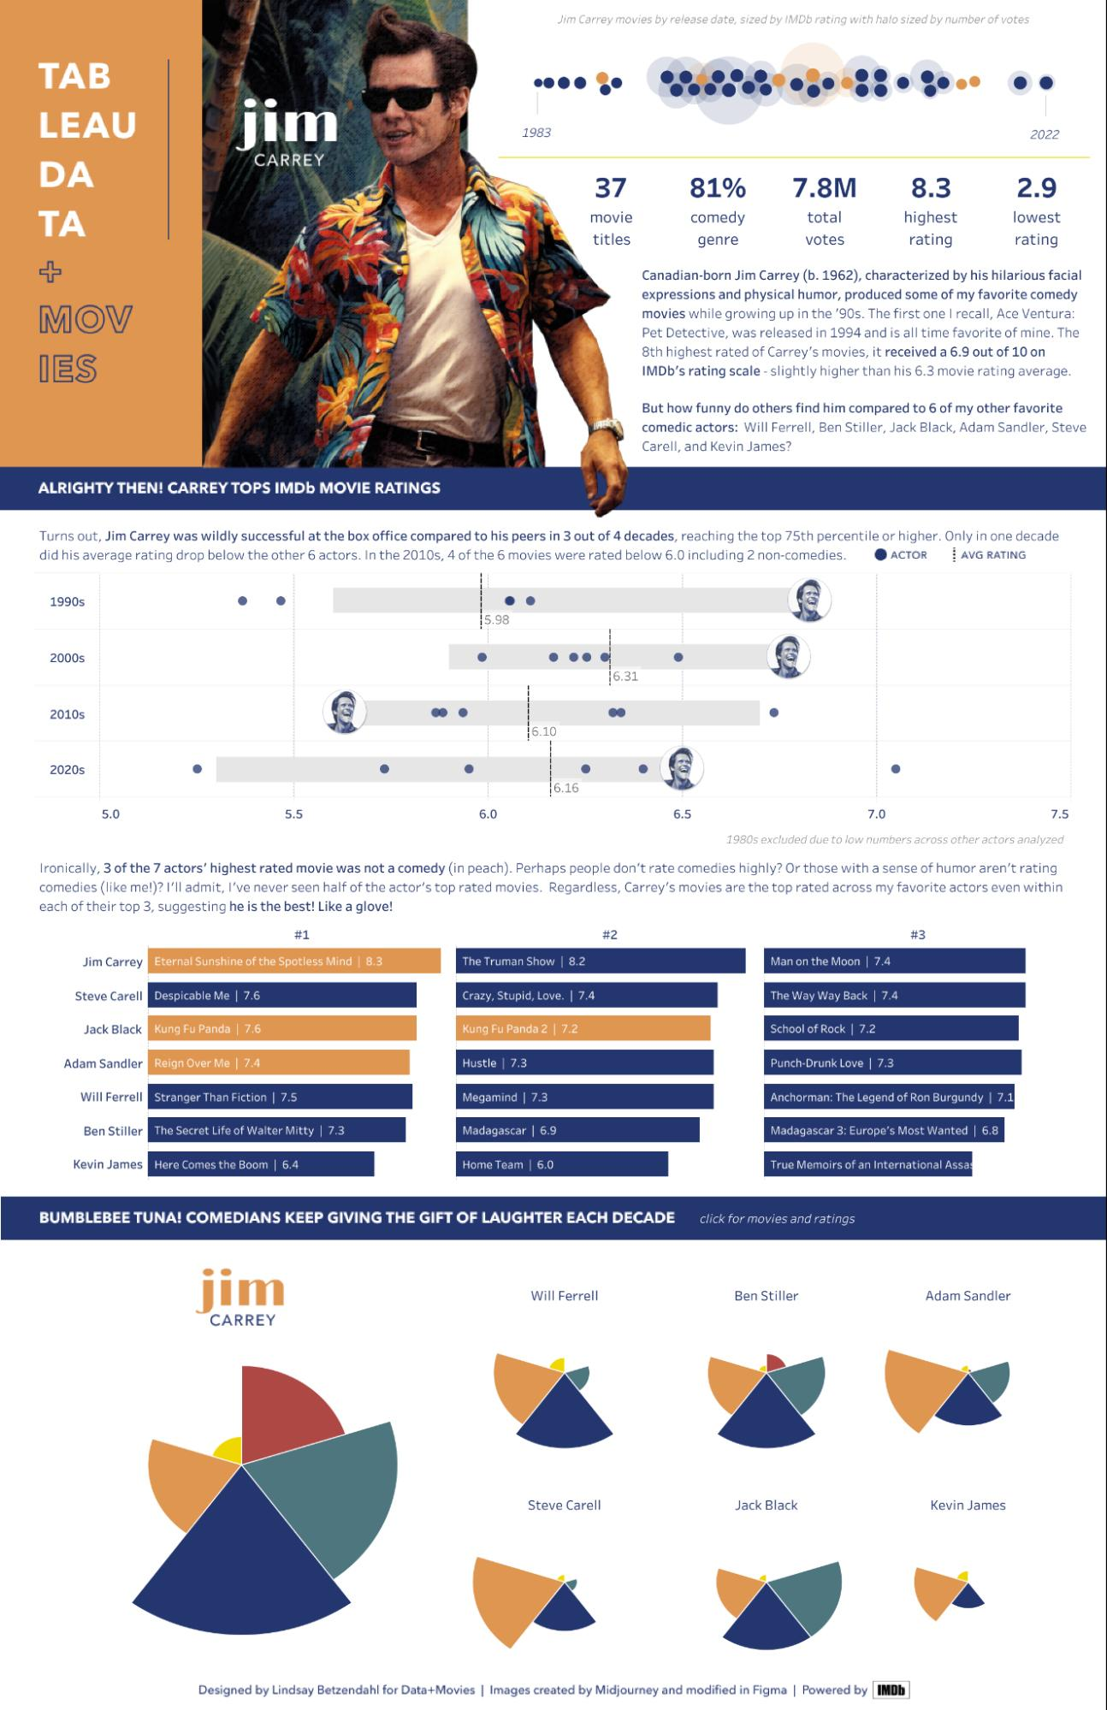
Differences
01
02
Tableau Dashboard
Our Project - MDVP
It offers insights into Jim Carrey's movie career, focusing on IMDb ratings, audience votes, and comparisons with other comedic actors.
We enable users to analyze industry-wide patterns across genres, regions, languages, and movie durations rather than just specific actors.
Based on Tableau
From Scratch
Dashboard only
Platform

Slide 24
Comparison Table
 | Chinese Movie Platform | Dashboard PowerBI | Dashboard Tableau | MDVP
Diverse
Advanced |  |  |  | /
Worldwide
From Scratch

Slide 25
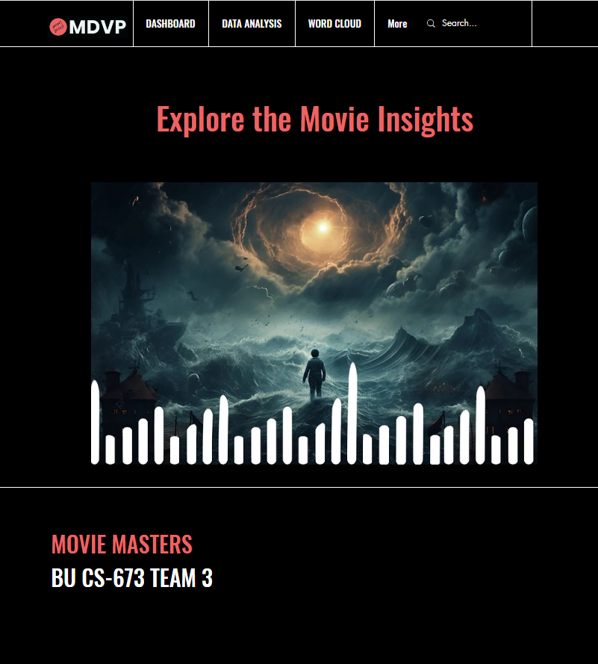
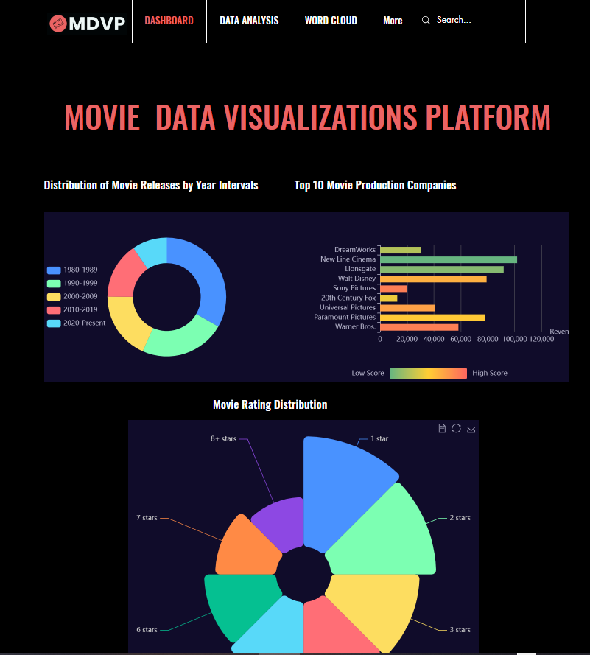
Dynamic Demo-MDVP

Slide 26
Thanks!
Do you have any questions?
Please keep this slide for attribution

